Slide 1
Analyzing student activity in the Computer Programming course
Tartu 2023

Slide 2
Team Introduction
Project Owner : Reimo Palm – course instructor
L
Result analysis, Webpage construction of dynamic effect display
Lanxiang
Zhang
Jian Zhang
Yucui Wu
Xinyue Zhang
J
Categorizing students
Continuous optimization
Y
Data Cleaning, Predicting final scores, Final Presentation
X
Data Consolidation, Optimizing predicted scores, Intermediate Presentation

Slide 3
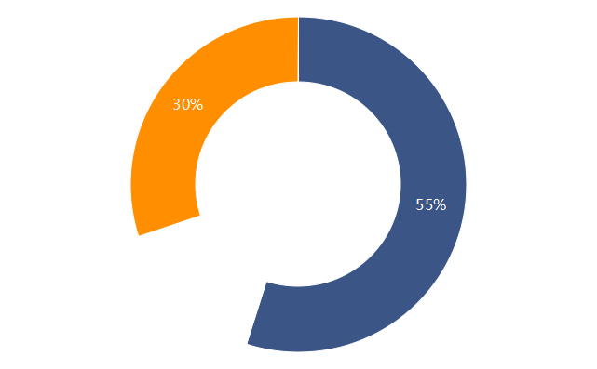
Project Motivation
Predict the final score based on
their early activity
Help students to modify their learning patterns to improve learning outcomes
Help teachers to modify their teaching models to improve teaching effectiveness
Classify the students based on
their typical study patterns
Tap into more effective teaching models
and strategies

Slide 4
Methods
Features & Models for Predicting
Number of attempts for each activity + Maximum score for each activity
Linear Regression
Decision Trees
Random Forest
Features & Models for Classifying
Total number of all attempts + The sum of the highest scores of all activities
K-Nearest Neighbors
Support Vector Machines
Neural Networks
XGBoost
best
Experimenting with
different models
Feature Engineering
Data Preprocessing & Merging

Slide 5
Results
MSE/MAE | Number of attempts for each activity + Maximum score for each activity
Linear Regression | 395.7/13.7
Decision Trees | 444.8/14.1
Random Forest | 282.3/11.4
截
图

Slide 6
Results
截
图
Genius type
They submit each assignment only 1 or very few times, but they get high grades and end up high final score.
Effort type
They attempted a lot, their scores gradually improved each time, and their final scores were high.
Needs help type
They tried a lot, but their scores didn't go up significantly last week, and their final scores weren't very good.
combo 1 :
combo 2:
combo 3:
combo 4:
Unmotivated learning type
They attempted very little, their scores were low, and their final scores were poor.

Slide 7
Lessons
Data
Is there enough data?
Is the data balanced?
Is the data clean?
How many features are to be collected?
How are they selected?
Features
Models
How to choose a model?
How many models to use for comparison?

Slide 8
Thank you !

